Slide 1
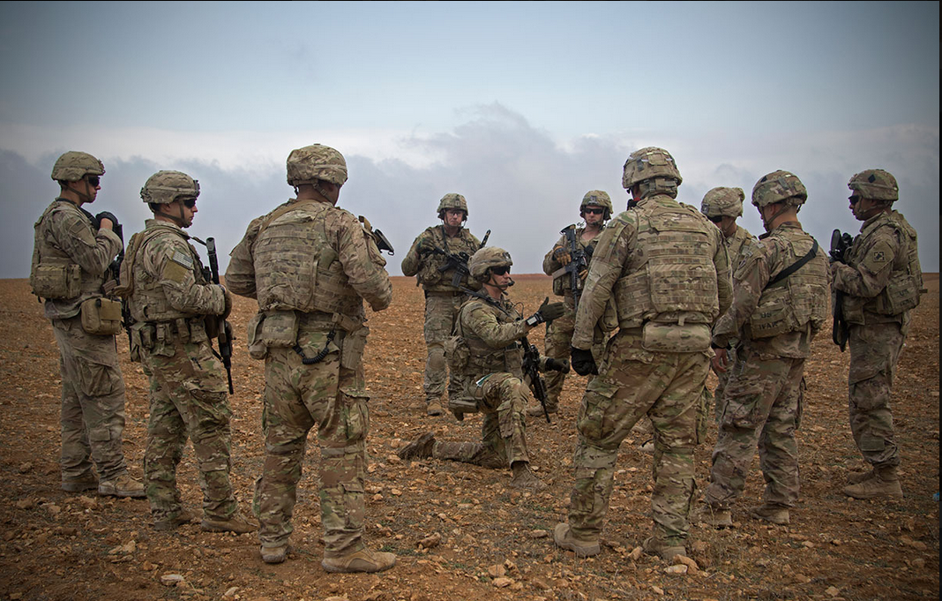
What is happening?
Notes:
What part of the mission command process do you see?
Give examples of how a Commander impacts the momentum of the battle.

Slide 2

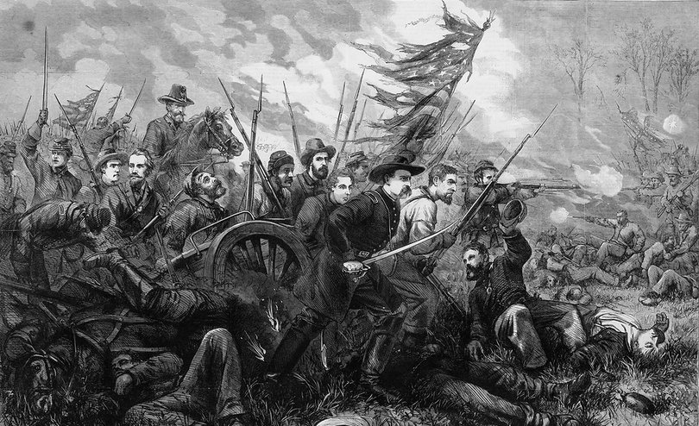


M448 Mission Command: Command
Master Leader Course
Introduction
Leaders Build Lethality, We Develop Leaders!

Slide 3
Lesson Scope
This is a two-hour lesson that interprets the elements and nature of command as a integral part of mission command. During this lesson, you will explore the Army’s approach to the command portion of mission command through the lens as a warfighting function. The focus of this lesson will cover the nature and elements of command, the role of commanders during operations. At the end of this lesson, the learner will be able to identify elements and the nature of command, and provide guides to effective command as it relates to the senior NCO.

Slide 4
Enabling Learning Objective
ELO-400-MLC-0470.2
Action: Examine the Army philosophy of mission command: Command.
Condition: In a group learning environment, given references and collaboration.
Standard: Based on a case study, summarize your findings and address important considerations that include:
Pointing Out the Elements and Nature of Command;
Informing the NCO of the commander’s role during operations; and
Illustrating Guides to Effective Command.
Learning Domain: Cognitive
Level of Learning: Analysis

Slide 5
Nature of Command
How does the “art of command” influence Senior NCO’s duties and responsibilities?
Notes:
Who Commands?
What is the art of command?
2-1. Command is the authority that a commander in the armed forces lawfully exercises over subordinates by virtue of rank or assignment. Command includes the authority and responsibility for effectively using available resources and for planning the employment of, organizing, directing, coordinating, and controlling military forces for the accomplishment of missions. It also includes responsibility for health, welfare, morale, and discipline of assigned personnel.
2-2. Command is personal. The commander alone is responsible for what the command does or fails to do.
2-3. Command is more art than science because it depends on actions only human beings can perform, to include judgment. The art of command is the creative and skillful exercise of authority through timely decision making and leadership. Proficiency in the art of command stems from years of schooling, self-development, introspection, and operational and training experiences.
ADP 6-0

Slide 6
Elements of Command
Authority
Decision Making
Judgement
Leadership
Command Presence
Location of Commander
Notes:
Which of the elements of command are you most comfortable operating under?
2-5. The elements of command are authority, responsibility, decision making, and leadership. The definition of command refers explicitly to authority. Along with authority comes responsibility—the obligation to carry forward an assigned task to a successful conclusion. Commanders exercise their authority by making decisions and leading their command in implementation of those decisions. Successful commanders develop skill in each element through maturity, experience, and education.
AUTHORITY
2-6. Authority is the right and power to judge, act, or command. Commanders understand that operations affect and are affected by human interactions.
2-7. Commanders may delegate authority to subordinates to accomplish a mission or assist in fulfilling their responsibilities. This includes delegating authority to members of their staffs and noncommissioned officers. Delegation allows subordinates to decide and act for their commander, or in their commander’s name, in specified areas.
RESPONSIBILITY
2-8. Commanders are legally and ethically responsible for their decisions and for the actions, accomplishments, and failures of their subordinates. Commanders may delegate authority, but delegation does not absolve commanders of their responsibilities to their higher commander.
2-9. The importance of the mission informs commanders how much risk to Soldiers and equipment to accept. When there is conflict among the three, mission accomplishment comes before Soldiers, and Soldier.
DECISION MAKING
2-10. Decision making involves applying both the art and science of war. They belong to the science of war and are important to understanding what is possible with the resources available. Other aspects—the impact of leadership, complexity of operations, and uncertainty about the enemy—belong to the art of war.
2-12. Decision making requires knowing if, when, and what to decide as well as understanding the consequences of that decision. Critical to decision making is the ability to make decisions without perfect information, knowing when enough information allows acceptable decisions, and the willingness to act on imperfect information. Striking the balance between acting now with imperfect information and acting later with better information is essential to the art of command.
2-13. Situational understanding is the product of applying analysis and judgment to relevant information to determine the relationships among the operational and mission variables. Situational understanding allows commanders to make effective decisions and regulate the actions of their force with plans appropriate for the situation. It enables commanders and staffs to assess operations accurately. Commanders and staffs continually strive to maintain their situational understanding and work through periods of reduced understanding as a situation evolves.
2-21. Commanders and staffs apply critical and creative thinking to decision making. Critical thinking examines a problem in depth from multiple points of view.
2-22. Creative thinking involves thinking in new, innovative ways using imagination, insight, and different ideas.
2-23. Effective commanders consider their experience, their staff’s experience, and the time and information available when considering their decision-making approach.
Judgment
2-30. Commanders make decisions using judgment acquired from experience, training, and study. Experience contributes to judgment by providing a basis for rapidly identifying practical courses of actions and dismissing impractical ones. Commanders use judgment to assess information, situations, or circumstances shrewdly and to draw feasible conclusions. Skilled judgment helps commanders form sound opinions and make sensible decisions.
2-32. Judgment becomes more refined as commanders become more experienced. Commanders apply their judgment to—
Identify, accept, and mitigate risk
Delegate authority
Prioritize resources
Direct the staff
Direct the Staff
2-48. Commanders rely on and expect initiative from staff officers as much as from subordinate commanders.
2-49. Within their headquarters, commanders exercise their judgment to determine when to intervene and participate personally in staff operations, as opposed to letting their staffs operate on their own based on guidance. Commanders cannot do everything themselves or make every decision; such participation does not give staffs the experience mission command requires. However, commanders cannot simply approve staff products produced without their input. Commanders participate in staff work where it is necessary to guide their staffs. They use their situational understanding and commander’s visualization to provide guidance from which their staffs produce plans and orders. In deciding when and where to interact with subordinates, the key is for commanders to determine where they can best use their limited time to greatest effect—where their personal intervention will pay the greatest dividend.
Leadership
2-53. Commanders are both leaders and followers. Successful commanders recognize the responsibilities they and their subordinates have to the next higher echelon and the larger formation overall.
2-54. Commanders know the status of their forces. Command sergeants major, first sergeants, and platoon sergeants play vital roles in providing the commander awareness about the morale and physical condition of their Soldiers. Commanders need to know when circumstances may prevent friendly forces from performing to their full potential. For example, a subordinate unit may have recently received inexperienced replacements, may have lost cohesion due to leader casualties, or may be extremely fatigued due to an extended period of operations.
Command Presence
2-57. Command presence is the influence commanders have on those around them through their personal demeanor, appearance, and conduct. Commanders use their presence to gather and share information and assess operations through personal interaction with subordinates. It allows commanders to assess intangibles like morale and provide direct feedback on subordinate performance. Commanders employing the mission command approach ask questions without second-guessing their subordinate’s performance unless absolutely necessary. Command presence establishes a background for all plans and procedures so that subordinates can understand how and when to adapt them to achieve the commander’s intent. Commanders can establish command presence in a variety of ways, including—
Being seen and heard
Sharing risk and hardship
Setting a good personal example
Ensuring their commander’s intent is widely understood
Providing clear face-to-face commander’s guidance
Back briefs and rehearsals
Location of the Commander
2-64. Where a commander is located can bring the leadership element of combat power directly to the decisive operation, especially when that location allows for personal presence and the ability to directly observe events. Commanders gain firsthand appreciation for the human dimension of a situation that can rarely be gained any other way. Equally important, they can avoid the delays and distortions that occur as information travels down and up the chain of command. Finally, by their presence, commanders direct emphasis to critical spots and focus efforts on them. Common to all echelons of command, these factors influence the decision on the commander’s location:
The need to understand the situation
The need to make decisions
The need to communicate
The need to motivate subordinates
2-65. The commander’s forward presence demonstrates a willingness to share danger and hardship. It also allows commanders to appraise for themselves a subordinate unit’s condition, including its leaders’ and Soldiers’ morale. Forward presence allows commanders to sense the human dimension of conflict, particularly when fear and fatigue reduce effectiveness.
2-66. Commanders cannot let the perceived advantages of improved information technology compromise their obligation to personally lead by example.
ADP 6-0

Slide 7
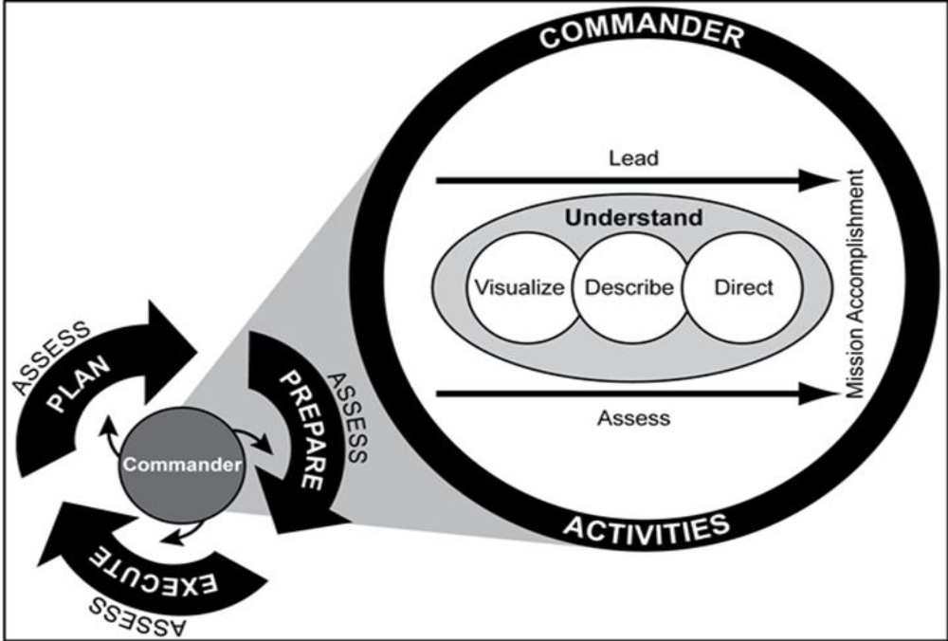
Role of Commanders in Operations
Notes:
: “See ADP 5-0 for a detailed discussion of the operations process. Figure found in ADP 3-0, 31 July 2019, para 4-2.”
Why is the commander the most important participant in the process of planning, preparing, and executing operations?
2-70. Commanders, staffs, and subordinate units employ the operations process to integrate and synchronize the warfighting functions across multiple domains and synchronize forces to accomplish missions. This includes integrating numerous processes such as intelligence preparation of the battlefield, the military decision-making process, and the targeting process within the headquarters and with higher echelon, subordinate, supporting, and supported units.
2-71. Commanders are the most important participants in the operations process. While staffs perform essential functions that amplify the effectiveness of operations, commanders drive the operations process through understanding, visualizing, describing, directing, leading, and assessing operations as shown in figure 2-2. Accurate and timely running estimates maintained by staffs assist commanders in understanding the situation and making decisions throughout the operations process.
Understand
2-74. Commanders collaborate with their staffs, other commanders, and unified action partners to build a shared understanding of their operational environment and associated problems. Planning, intelligence preparation of the battlefield, and running estimates help commanders develop an initial understanding of their operational environment. Commanders direct reconnaissance and develop the situation through action to improve their understanding. Commanders circulate within the area of operations as often as possible, collaborating with subordinate commanders and speaking with Soldiers. Using personal observations and inputs from others (including running estimates from their staffs), commanders improve their understanding of their operational environment throughout the operations process.
Visualize
2-75. As commanders begin to understand their operational environment, they start visualizing a desired end state and potential solutions to solve or manage identified problems. Collectively, this is known as commander’s visualization—the mental process of developing situational understanding, determining a desired end state, and envisioning an operational approach by which the force will achieve that end state.
2-76. In building their visualization, commanders first seek to understand those conditions that represent the current situation. Next, commanders envision a set of desired future conditions that represents the operation’s end state. Commanders complete their visualization by conceptualizing an operational approach—a broad description of the mission, operational concepts, tasks, and actions required to accomplish the mission.
Describe
2-77. Commanders describe their visualization to their staffs and subordinate commanders to facilitate shared understanding and purpose throughout the force. During planning, commanders ensure subordinate commanders understand their visualization well enough to begin course of action development. During execution, commanders describe modifications to their visualization in updated planning guidance and directives resulting in fragmentary orders that adjust the original operation order. Commanders describe their visualization in doctrinal terms, refining and clarifying it as circumstances require. Commanders describe their visualization in terms of—
Commander’s intent
Planning guidance, including an operational approach
Commander’s critical information requirements
Essential elements of friendly information
Direct
2-78. To direct is implicit in command. Commanders direct action to achieve results and lead forces to mission accomplishment. Commanders make decisions and direct action based on their situational understanding maintained by continuous assessment. Throughout the operations process, commanders direct forces by:
Preparing and approving plans and orders
Establishing command and support relationships
Assigning and adjusting tasks, control measures, and task organization
Positioning units to maximize combat power
Positioning key leaders at critical places and times to ensure supervision
Allocating resources to exploit opportunities and counter threats
Committing the reserve as required
Lead
2-79. Commanders lead by example and personal presence. Leadership inspires subordinates to accomplish things that they otherwise might not. Where a commander locates within an area of operations is an important consideration for effective mission command. Through leadership, commanders provide purpose, direction, and motivation to subordinate commanders, their staffs, and Soldiers. There is no standard pattern or simple prescription; different commanders lead differently. Commanders balance their time among command posts and staffs, subordinate commanders, forces, and other organizations to make the greatest contribution to success. (See ADRP 6-22 for a detailed discussion of leadership, including attributes of effective leaders.)
Assess
2-80. Commanders continuously assess the situation to better understand current conditions and determine how an operation is progressing. Continuous assessment helps commanders anticipate and adapt the force to changing circumstances. Commanders incorporate the assessments of their staffs, subordinate commanders, and unified action partners into their personal assessment of the situation. Based on their assessment, commanders adjust their visualization and modify plans to adapt the force to changing circumstances.
2-81. A commander’s focus on understanding, visualizing, describing, directing, leading, or assessing throughout operations varies during different operations process activities. For example, during planning commanders focus more on understanding, visualizing, and describing while directing, leading, and assessing. During execution, commanders often focus more on directing, leading, and assessing—while improving their understanding and modifying their visualization as needed. (See ADP 5-0 for a detailed discussion on assessing operations.)

Slide 8
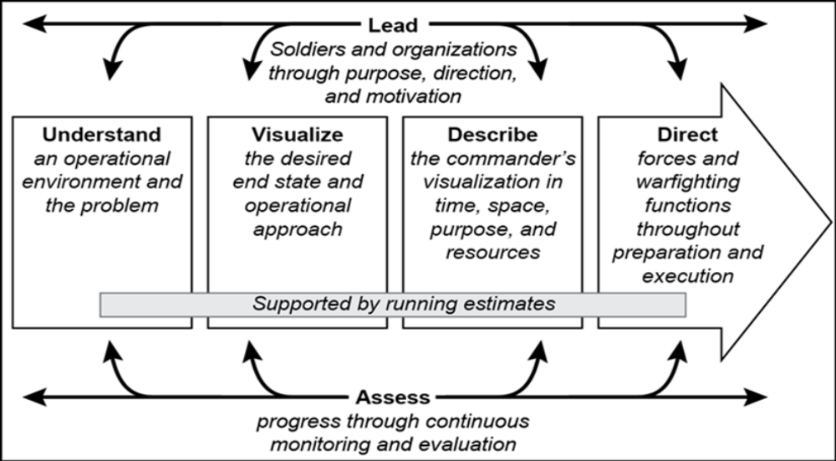
Senior NCO’s Mission Command
Support Role
Notes:
ADP 6-0, Figure 2-2. This slide contains the MOST relevant and crucial information related to the lesson.”
What crucial function does the NCO serve as related to Mission Command?
2-107. Noncommissioned officers are key enablers of mission command, and they must be trained in the mission command principles to effectively support their commander and lead their Soldiers. Noncommissioned officers are required to exercise initiative to make decisions and take actions to further their commander’s intent.
DL Note: Add text “Answer question in your journal before selecting further analysis button.” Add further analysis button. Place the answer into further analysis.
When have you found yourself uncomfortable exercising “disciplined” initiative?
2-108. Noncommissioned officers enforce standards and discipline and develop their subordinates as they build teams. They are trained to operate under mission orders and decide for themselves how best to achieve their commander’s intent. With information available to all levels of command and increasing dispersion on the battlefield, noncommissioned officers must be comfortable in exercising initiative to make decisions and act.

Slide 9
Guide to Effective Command
Create a Positive Command Climate
Accept Subordinates’ Risk Taking and Errors
Build Trust and Shared Understanding
Communicate With Subordinates
Build Teams
Ensure Unity of Effort
Train Subordinates
Make Timely Decisions and Act
Notes:
Give concrete examples of how the Senior NCO Mission Command Support role supported the guides to effective command.
2-82. The guides to effective command help commanders fulfill the fundamental responsibilities of command. A commander’s use of these guides must fit the situation, the commander’s personality, and the capability and understanding of subordinates. Command cannot be scripted. These guides apply at all levels of command. Mission command provides a common baseline for command during operations and garrison activities.
The following guides aid commanders in effectively exercising command and inculcating mission command—
Create a positive command climate
Ensure unity of effort
Train subordinates on command and control and the application of mission command
Make timely and effective decisions and act
Create a Positive Command Climate
2-84. Successful commanders recognize that all subordinates contribute to mission accomplishment. They establish clear and realistic goals and communicate their goals openly. Commanders establish and maintain communication between subordinates and leaders. They encourage subordinates to bring creative and innovative ideas to the forefront. They also seek feedback from subordinates. The result is a command climate that encourages initiative.
2-86. In a positive command climate, the expectation is that everyone lives by and upholds the moral principles of the Army Ethic. The Army Ethic must be espoused, supported, practiced, and respected. Mission command depends on a command climate that encourages subordinate commanders at all levels to take the initiative. Commanders create a positive command climate by—
Accepting subordinates’ risk taking and errors
Building mutual trust and shared understanding
Communicating with subordinates
Building teams
Ensure Unity of Effort
2-99. Unity of effort is the coordination and cooperation toward common objectives, even if the participants are not necessarily part of the same command organization, which is the product of successful unified action. Establishing a culture of collaboration provides and enhances unity of effort. The commander’s intent provides the unifying idea that allows decentralized execution within an overarching framework.
2-100. Unity of command is one of the principles of war and the preferred method for achieving unity of effort. Commanders always adhere to unity of command when task-organizing Army forces. Under unity of command, every mission falls within the authority and responsibility of a single, responsible commander.
2-101. Unity of command may not be possible in some operations that include unified action partners. When unity of command is not possible, commanders must achieve unity of effort through cooperation and coordination to build trust among all elements of the force—even if they are not part of the same command structure.
2-102. The commander’s intent provides guidance within which individuals are expected to exercise initiative to accomplish overall goals. Understanding the commander’s intent two echelons up further enhances unity of effort while providing the basis for decentralized decision making and execution. Subordinates who understand the commander’s intent are more likely to exercise initiative in unexpected situations. Under mission command, subordinates have an absolute responsibility to fulfill the commander’s intent.
Train Subordinates in Command and Control and the Application of Mission Command
2-106. Effective mission command requires well-developed subordinates capable of decentralized
execution of missions and tasks. Training must create common, repetitive, shared experiences that build trust and allow commands to acquire competence in shared understanding. Trained teams are able to communicate explicitly and implicitly, conduct decentralized operations, and achieve unity of effort in uncertain situations.
Make Timely Decisions and Act
2-117. Timely decisions and actions are essential for effective command and control. Commanders who demonstrate the agility to consistently make appropriate decisions faster than their opponents have a significant advantage. By the time the slower commander decides and acts, the faster one has already changed the situation, rendering the slower commander’s actions irrelevant. With such an advantage, the faster commander can dictate the tempo and maintain the operational initiative.
2-118. A mission command approach makes it easier for commanders to make timely decisions that exploit opportunities because they spend less time focused on subordinates’ tasks.
Effective commanders—
Take their opponent’s plans, capabilities, and reaction times into account when making decisions
Consider the impact of their decisions—the cause and effect
Make decisions quickly—even with incomplete information
Adopt a satisfactory course of action with acceptable risk as quickly as possible
Delegate decision making authority to the lowest echelon possible to obtain faster decisions during operations
Support decentralized execution by continuously sharing knowledge with subordinates and frequently with adjacent commanders
2-119. Commanders change and combine intuitive and analytical decision making techniques as the situation requires. Because uncertainty and the tempo of large-scale combat operations drive most decisions, commanders emphasize intuitive decision making and develop their subordinates accordingly. However, when time is available and depending on the operational context of a situation, commanders and staffs use the military decision-making process or Army design methodology during planning.
2-120. Commanders can alter planning to fit time-constrained circumstances. In time-constrained conditions, commanders assess the situation, update their commander’s visualization, and direct their staffs to perform those activities needed to support the required decisions. Streamlined processes permit commanders and staffs to shorten the time needed to issue orders when the situation changes. To an outsider, it may appear that experienced commanders and staffs omit key steps. In reality, they use existing products or perform steps mentally.
Based on your CMF, give some examples of when outdated running estimate information hindered the commander’s accurate visualization of an operation?
2-121. Commanders and staffs constantly assess where an operation is in relation to the end state and make adjustments to accomplish the mission and posture the force for future operations. The commander’s visualization and the staffs’ running estimates are the primary assessment tools.
Keeping running estimates current is essential to ensuring commanders are aware of feasible options.
Staffs continuously replace outdated facts and assumptions in their running estimate with new information. They perform analysis and form new, or revise existing, conclusions and recommendations. The commander’s visualization identifies decisions commanders expect to make and focuses their staffs’ running estimates.
Up-to-date running estimates provide the recommendations commanders need to make timely decisions during execution.
2-122. The role of commanders is to direct and lead from the beginning of planning throughout execution, and continually assess and adjust operations to achieve their intent. Commanders drive the operations process. They understand, visualize, describe, direct, lead, and assess operations in complex, dynamic environments. Throughout operations, commanders, subordinate commanders, staffs, and unified action partners collaborate actively, sharing and questioning information, perceptions, and ideas to better understand situations and make decisions. Commanders encourage disciplined initiative through mission orders and a climate of mutual trust and shared understanding. Guided by their experience, knowledge, education, intelligence, and intuition, commanders apply leadership to translate decisions into action. Commanders synchronize forces and capabilities in time, space, and purpose to accomplish missions.
2-123. Ultimately, command reflects everything a commander understands about the nature of war, warfighting doctrine, training, leadership, organizations, materiel, and soldiers. It is how commanders organize their forces, structure operations, and direct the synchronized effects of organic and allocated assets toward their visualized end state. Command is built on training and mutual understanding by all Soldiers within that command about how it operates.

Slide 10
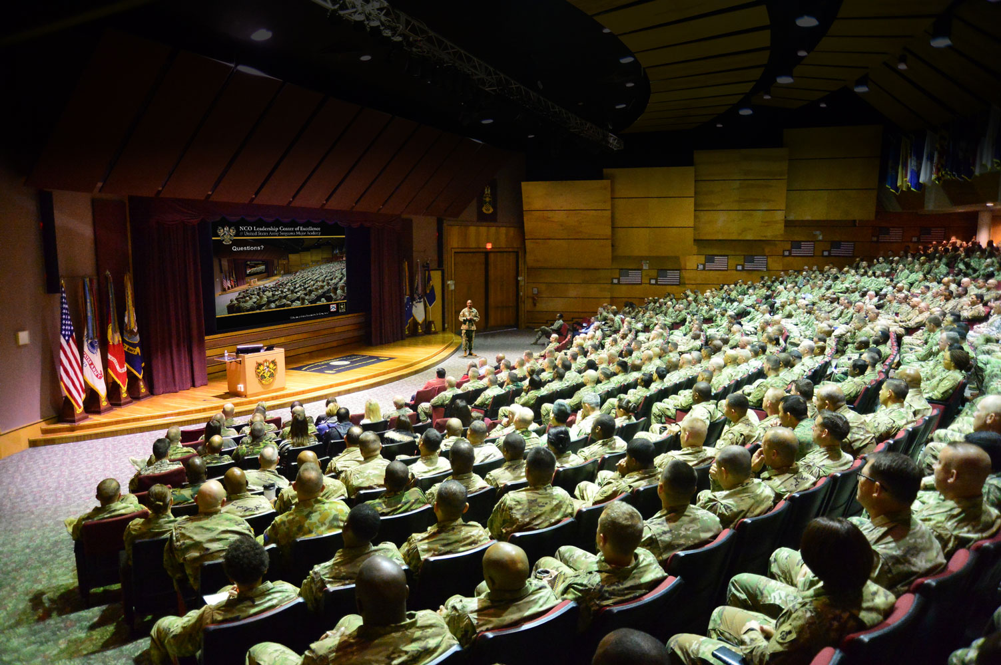

Master Leader Course
Questions?
M448 Mission Command-Command
Leaders Build Lethality, We Develop Leaders!
Notes:
This lesson links with Effective Leadership, Operational Art and Design, Critical Thinking and Problem Solving, and Effective Communication.
Where do you see yourself in the process of mission command?
How can you include your experience as an NCO to assist the commander in mission command?

